Slide 1

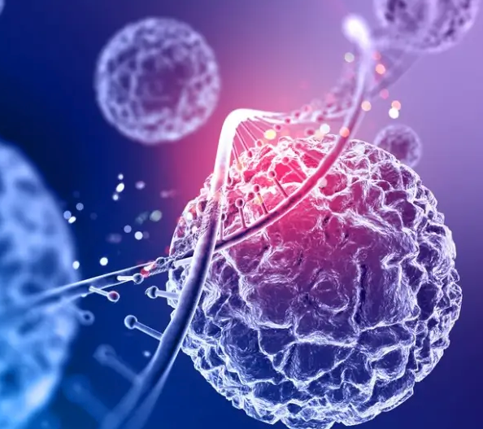
Metabolic Pathway & Enzyme Annotation Pipeline
Group 2
Aswini R (6)
Raj Gondane (12)
Sanjai C (26)

Slide 2
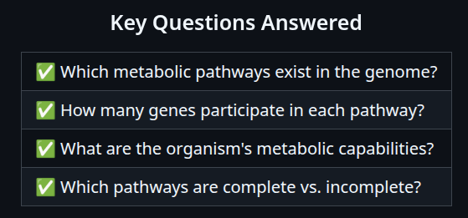
Why this pipeline ?
To analyze genome metabolic capabilities through enzyme annotation and pathway mapping.
2. What this Pipeline does ?
It Transforms raw genome sequences into comprehensive metabolic profiles byidentifying genes, annotating enzymes, and mapping them to KEGG pathways.

Slide 3
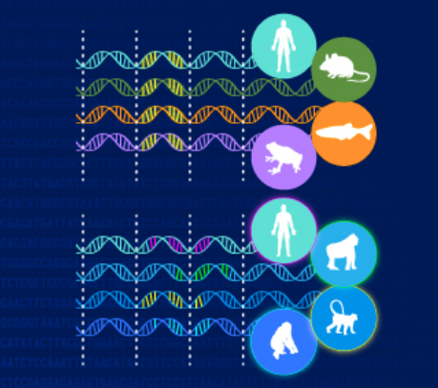
Introduction
Comparative genomics reveals shared and unique metabolic traits
Metabolic pathways show enzyme-driven biochemical reactions
KEGG Orthology (KO) links genes to enzyme functions and pathways
Enzyme annotation uncovers genome potential for metabolism and adaptation
Combines assembly, gene prediction, annotation, and pathway mapping
Aids understanding of ecological roles and evolutionary link

Slide 4
Workflow
📁 Raw FASTQ Reads ⬇️
🔍 FastQC Quality Assessment ⬇️
✂️ fastp Quality Trimming & Filtering ⬇️
🧩 SPAdes Genome Assembly ⬇️
🔬 Prokka Gene Prediction ⬇️
🧬 KOfamScan KO Annotation ⬇️
🗺️ KEGG Mapping Pathway Analysis ⬇️
📊 Pathway_counts.tsv Final Results

Slide 5
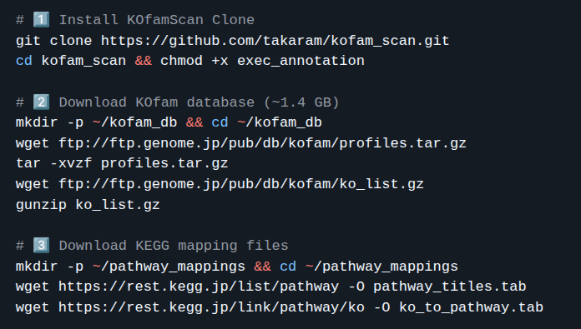
Workflow (Manual Run)
🔧 Quick Installation

Slide 6
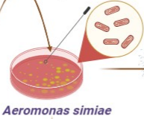
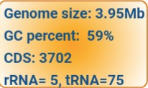
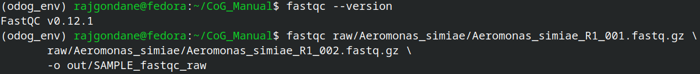
Step 1: FastQC
Setting Environment
Tool: FastQC Function: Performs initial quality assessment of raw sequencing reads to identify issues like low quality or adapter contamination.

Slide 7
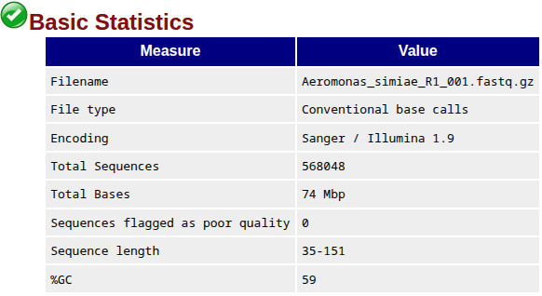
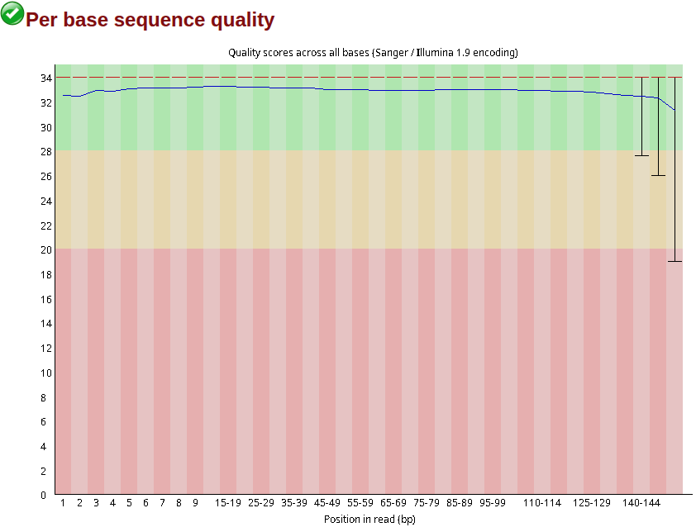
Step 1: FastQC Output

Slide 8
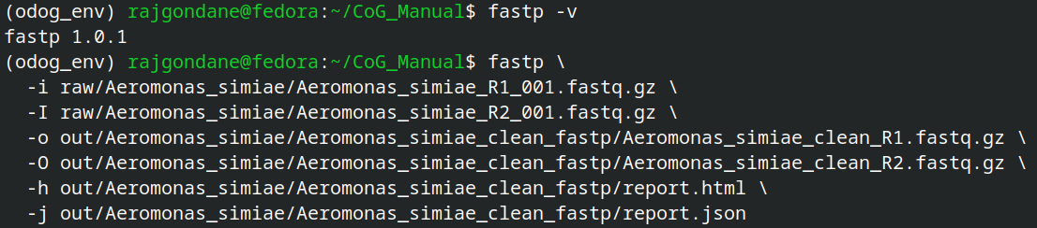
Step 2: fastp
Tool: fastp
Function: Trims adapters and filters low-quality bases to clean raw reads and improve downstream analyses.

Slide 9
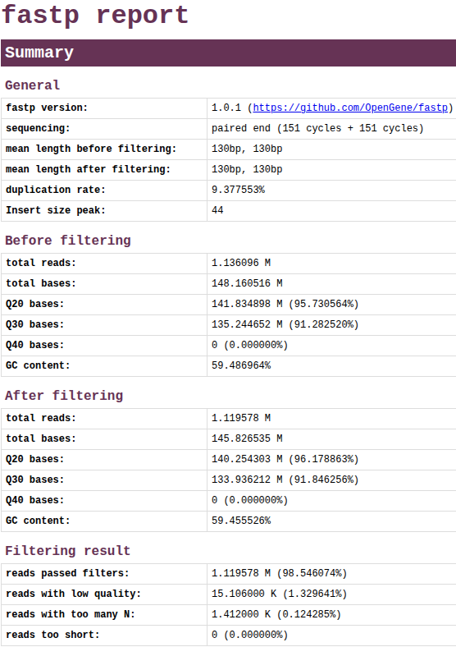
Step 2: fastp Output

Slide 10
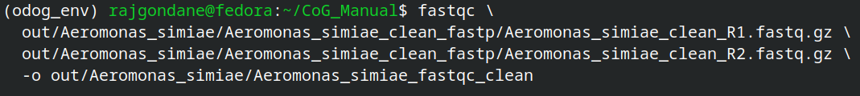
Step 3: FastQC (Post-trimming)
Tool: FastQC
Function: Re-assesses quality of cleaned reads to ensure trimming and filtering were successful.

Slide 11
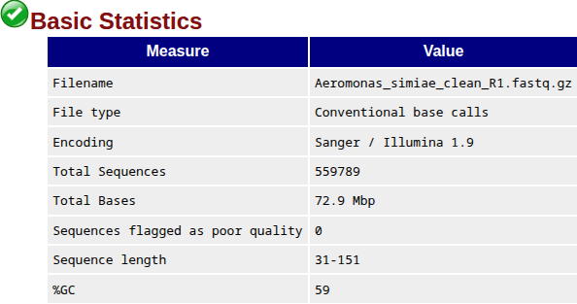

Step 3: FastQC (Post-trimming) Output

Slide 12
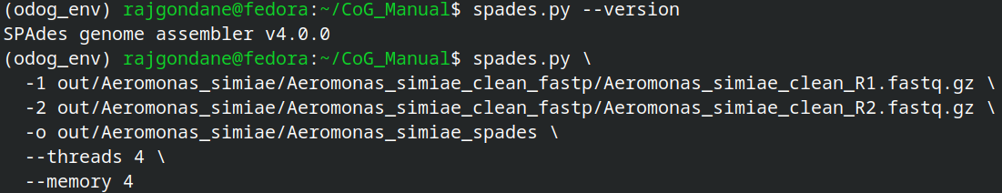
Step 4: SPAdes
Tool: SPAdes
Function: Assembles high-quality reads into longer contiguous sequences (contigs) that represent the genome.

Slide 13
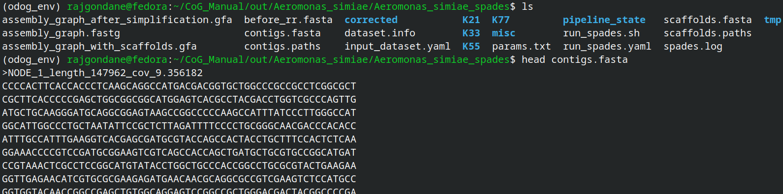
Step 4: SPAdes Output

Slide 14
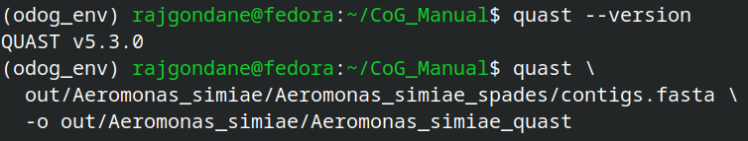
Step 5: QUAST
Tool: QUAST
Function: Evaluates assembly quality metrics like contig length and completeness.

Slide 15
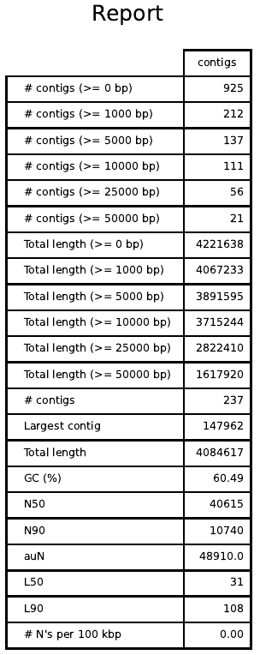
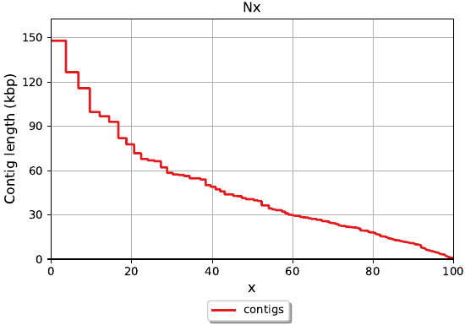
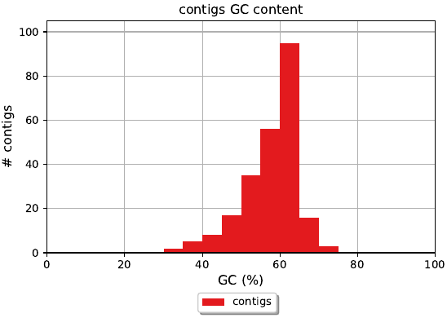
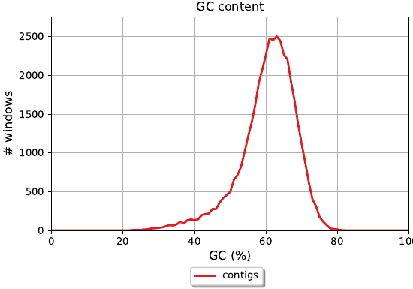
Step 5: QUAST Output

Slide 16
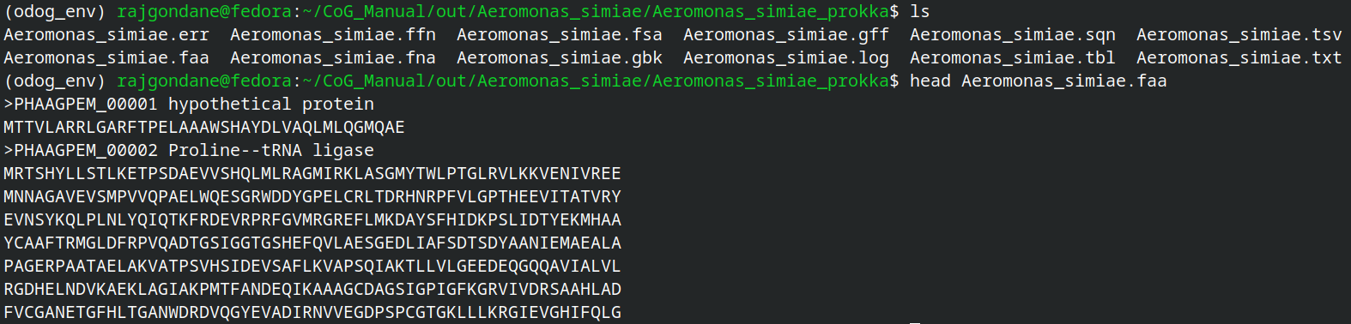
Step 6: Prokka
Tool: Prokka
Function: Predicts genes (protein-coding sequences) in assembled contigs and performs functional annotation.

Slide 17
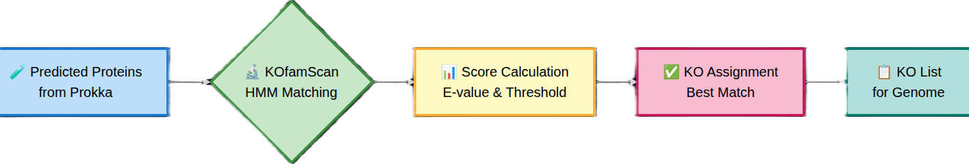
Step 7: KOfamScan
Tool: KOfamScan
Function: Assigns KEGG Orthology (KO) identifiers to predicted proteins using HMM profiles for enzyme annotation.

Slide 18
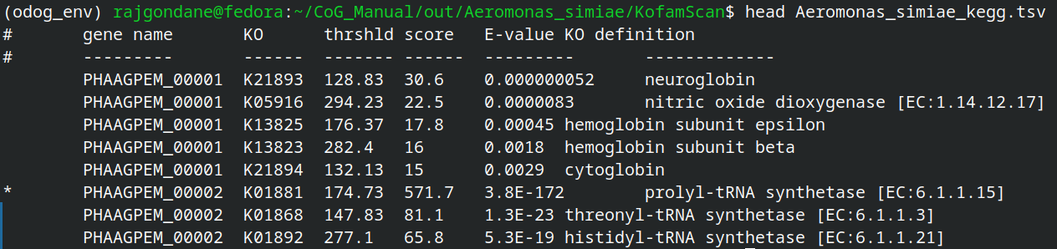
Step 7: KOfamScan Output

Slide 19
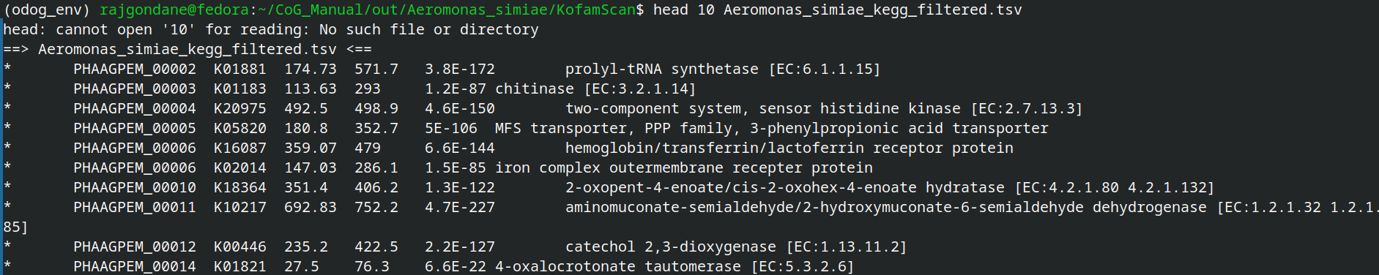
Step 8: Filter KO Annotations
Tool: grep
Function: Extracts high-confidence KO assignments by filtering KOfamScan output.
Output

Slide 20
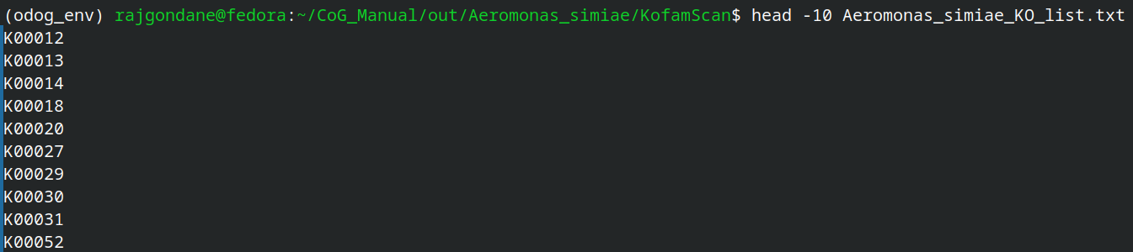
Step 9: Extract KO IDs
Tool: cut & sort
Function: Lists unique KO identifiers for pathway mapping.
Output

Slide 21
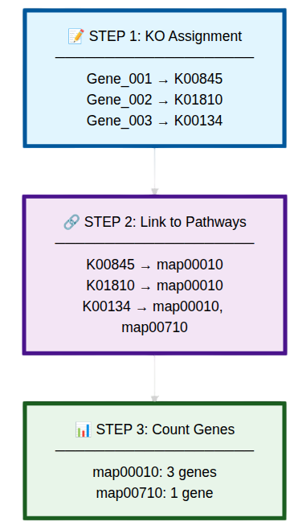
How KO to Pathway Mapping is done ?

Slide 22
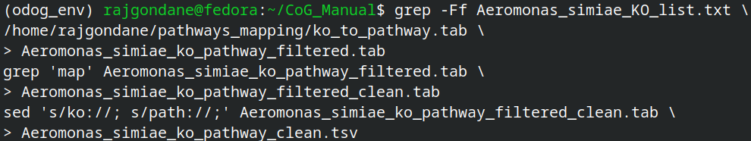
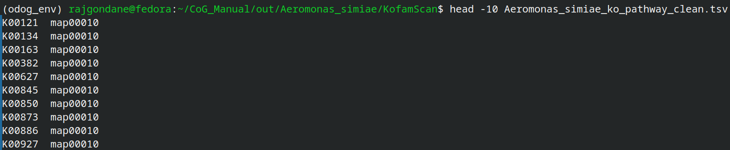
Step 10: KO Pathway Mapping
Tool: grep, sed
Function: Maps KO IDs to KEGG metabolic pathways using KEGG mapping tables.

Slide 23
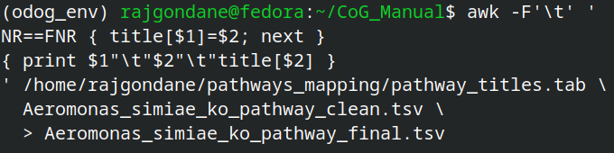
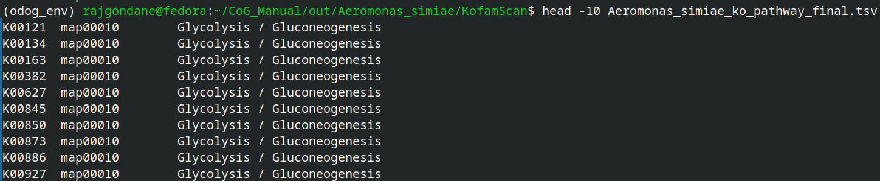
Step 11: Add Pathway Titles
Tool: awk
Function: Adds descriptive pathway names to KO-pathway mappings for clearer interpretation.

Slide 24
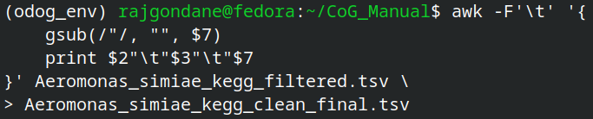
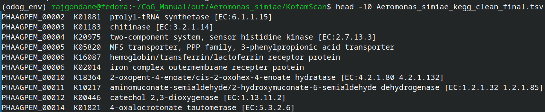
Step 12: Clean KO Table
Tool: awk
Function: Cleans and formats KO annotation data to prepare for merging.

Slide 25
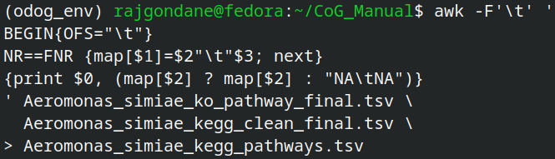
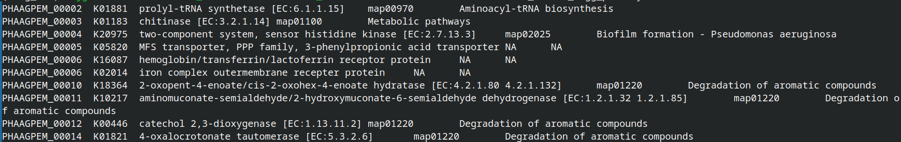
Step 13: Join KO and Pathways
Tool: awk
Function: Joins cleaned KO data with pathway mappings into a master annotation table.

Slide 26
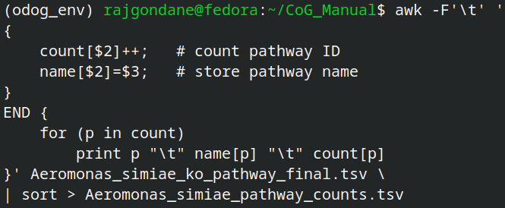
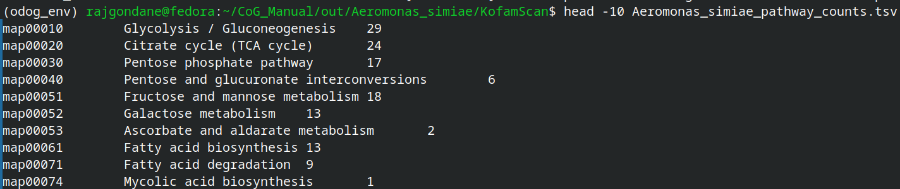
Step 14: Generate Pathway Counts
Tool: awk
Function: Counts the number of genes in each KEGG pathway, summarizing metabolic capabilities.

Slide 27
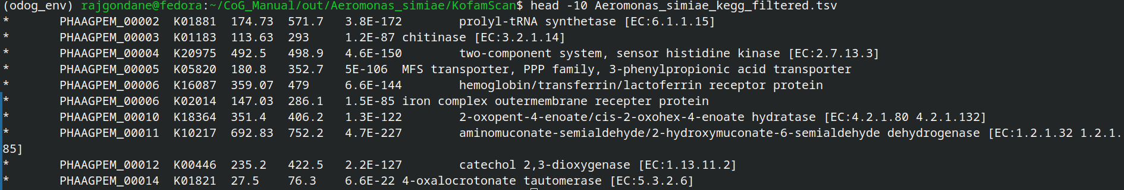
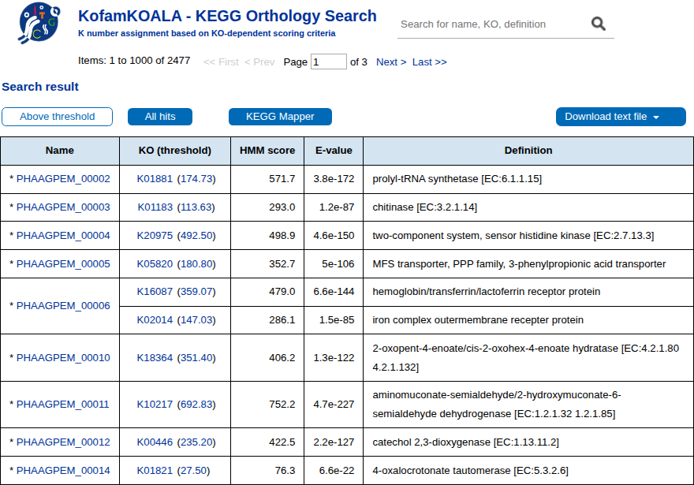
Cross-Validation of Results with Web-based tool
KofamKOALA
Total entries in Web tool & cmd = 2614

Slide 28
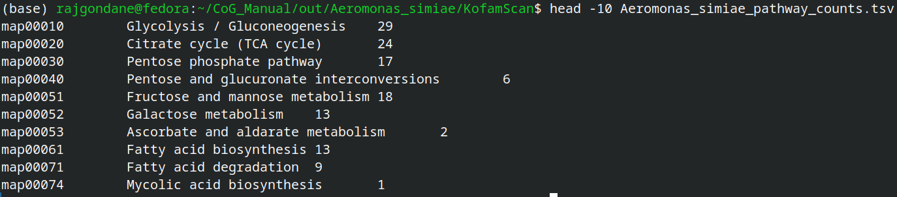
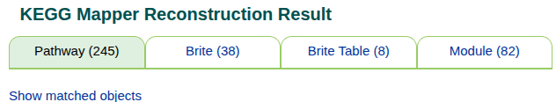
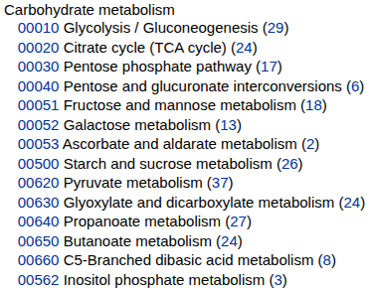
Cross-Validation of Results with Web-based tool
KEGG Mapper
Total entries in Web tool & CMD = 245

Slide 29
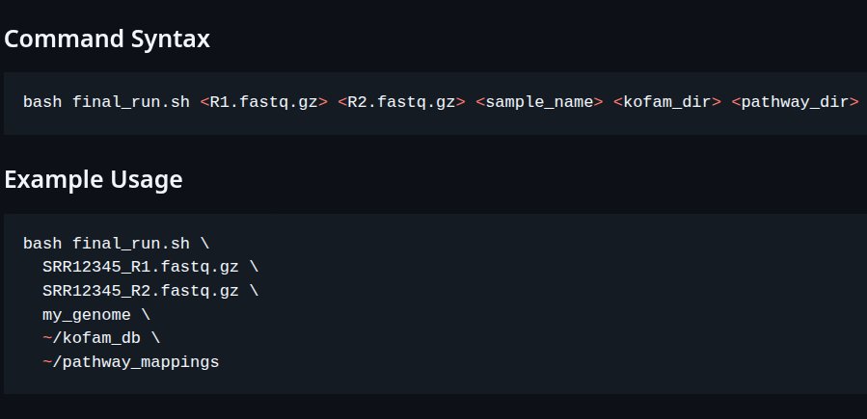

Automated Pipeline
final_run.sh file contains an automated running pipeline with conda Env as well as tools installation and its dependent packages.
https://github.com/Bharat-Genome-Database-BGDB/CoGe_Pipeline/tree/main/group%202

Slide 30
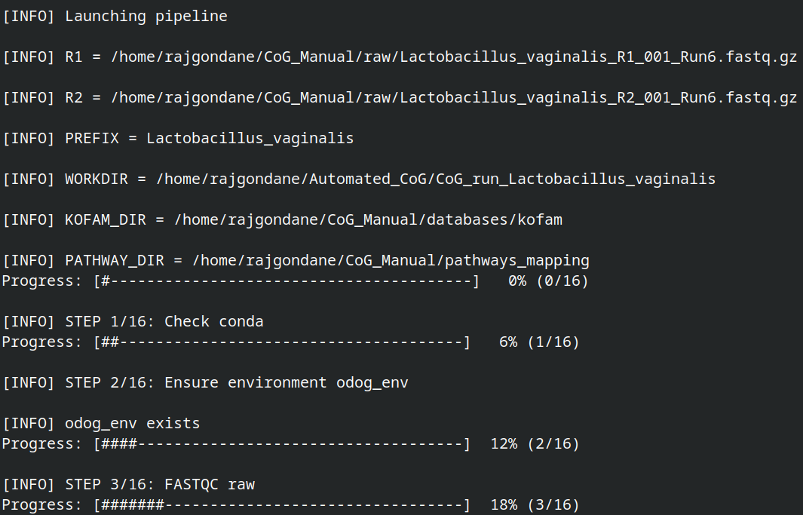
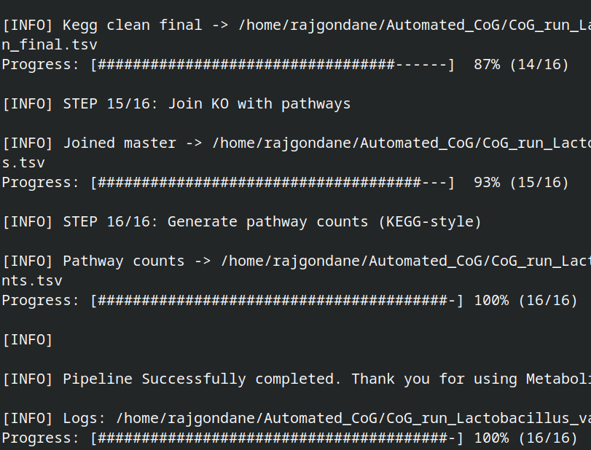
Pipeline running status

Slide 31
Conclusion
Built automated system to analyze genetic data and understand metabolic functions
Identified which enzymes are present in the organism's genome
Mapped genes to biochemical pathways showing what the organism can do
Revealed complete and missing metabolic capabilities
Helps understand organism's role in nature and evolution
Useful for Biotechnology, Medicine, and Drug Discovery
Works for any organism - bacteria, plants, or animals
Combines multiple software tools into one efficient workflow

Slide 32
THANK YOU !!

